Slide 1
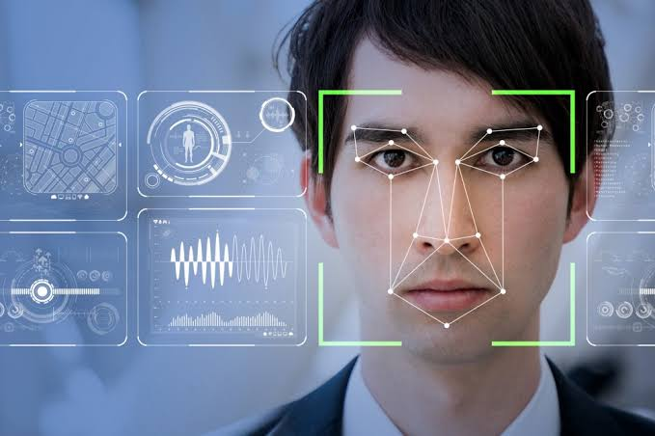
Mini Project on face Detection
By Prabhdeep Singh
Mentor :- Mr Ankit Gupta

Slide 2
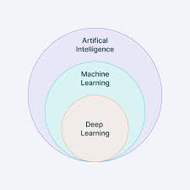
Introduction
The goal of this project is to detect and locate human face in image or video using opencv ,cnn and deep learning
Face detection is common practice used world wide with a combination of task as per use . it is made easy with the introduction of AI and Machine learning.

Slide 3

Problem Statement
To detect human face and be sure , it matches facial features
To display the percentage of facial expression matched

Slide 4
Methodology
Install
Install Numpy Libary (helps in mathematical computation)
Install
Install Imutils Library(used to start a videostream)
Install
Install Open CV(it is an widely used library for image processing)

Slide 5

Take input from the user (image or video stream )
Preprocess(change size and covert into grayscale) that image or frame from a video so that we can give it as an input to our model(convert into blob)

Slide 6
Process the image with the trained model and get the output
If the output is greater than confidence the create a rectangular box around the face and show the percentage of face matched

Slide 7

Conclusion and Future Work
This technology can be used in mask detection
Attendance System

